Slide 1
COMP.2030 Assembly Language Prog.
Website: https://pauldownen.com/courses/24S/Assembly
Blackboard
Homework/programming assignment submission
Lecture recordings: https://echo360.org/
Office Hours
MWF 10:30-11:30am
by appointment
TAs:
Nazim Belabbaci <NazimAhmed_Belabbaci@student.uml.edu>
Xingyu Lyu <Xingyu_Lyu@student.uml.edu>

Slide 2
Textbook and Outline
Textbook
Randal Bryant and David O’Hallaron
“Computer System: A Programmer’s Perspective,” 3rd ed. Prentice-Hall
http://csapp.cs.cmu.edu/public/students.html
Outline in roughly four parts
Chap 2 – Data Representation
MIPS Assembly Language
Chap 3 – Intel x86-64
Chap 4 – Hardware

Slide 3
Evaluation
Labs (2 absences are excused) | 15%
Homework | 30%
Midterm exam 1 | 15 %
Midterm exam 2 | 15 %
Final Exam | 25 %

Slide 4
How does a program execute?
Compute the class average
int total = 0;
int counter = 0;
int average;
while (grades[counter] >= 0) {
total = total + grades[counter];
counter = counter + 1;
}
if (counter > 0) {
average = total / counter;
print(average);
} else {
print('no grades entered’);
}

Slide 5
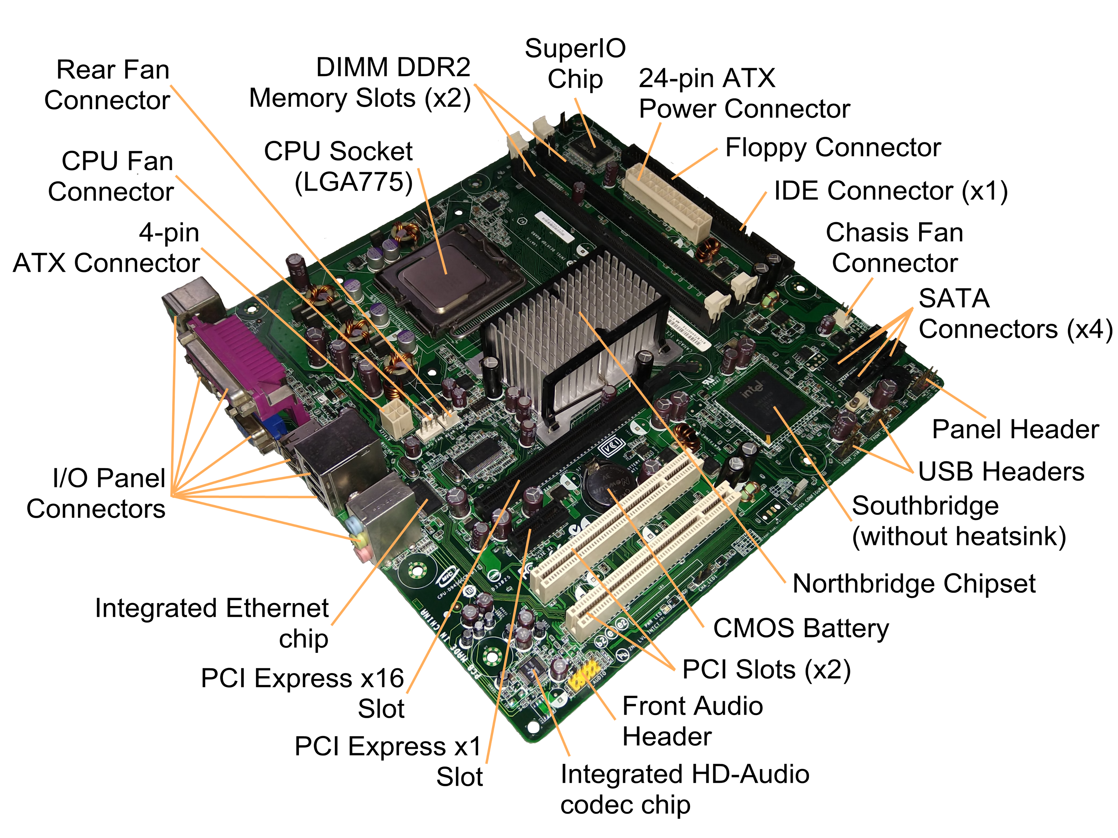
Hardware
from https://en.wikipedia.org/wiki/Motherboard
by JulianVilla26 - Own work, CC BY-SA 4.0, https://commons.wikimedia.org/w/index.php?curid=84225711

Slide 6
Hardware
from https://en.wikipedia.org/wiki/Motherboard

Slide 7
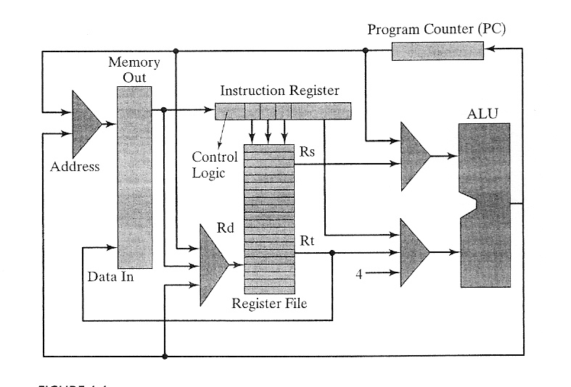
Hardware Schematics
CPU

Slide 8
Program execution in hardware
int total = 0;
int counter = 0;
int average;
while (grades[counter] >= 0) {
total=total+grades[counter];
counter = counter + 1;
}
if (counter > 0) {
average = total / counter;
print(average);
} else {
print('no grades entered’);
}

Slide 9
Hardware Organization
Fixed Resources:
CPU (Central Processing Unit)
ALU (Arithmetic & Logical Unit)
Register File
Program Counter (PC)
Instruction Register (IR)
Memory
I/O

Slide 10
Variables
Loop
Conditional
int total = 0;
int counter = 0;
int average;
while (grades[counter] >= 0) {
total = total + grades[counter];
counter = counter + 1;
}
if (counter > 0) {
average = total / counter;
print(average);
} else {
print('no grades entered’);
}

Slide 11
reg1 = 0
reg2 = 0
comp(reg2, 0)
int total = 0;
int counter = 0;
int average;
while (grades[counter] >= 0) {
total = total + grades[counter];
counter = counter + 1;
}
if (counter > 0) {
average = total / counter;
print(average);
} else {
print('no grades entered’);
}

Slide 12
reg1 = 0
reg2 = 0
comp(grades[reg2], 0)
if (LT) goto
comp(reg2, 0)
if (LE) goto else
reg4 = reg1/reg2
print(reg4)
goto exit
else:
print(“…”)
exit:
int total = 0;
int counter = 0;
int average;
while (grades[counter] >= 0) {
total = total + grades[counter];
counter = counter + 1;
}
if (counter > 0) {
average = total / counter;
print(average);
} else {
print('no grades entered’);
}

Slide 13
reg1 = 0
reg2 = 0
rept:
comp(grades[reg2], 0)
if (LT) goto done
Add reg1, reg1, grades[reg2]
Add reg2, 1, reg2
goto rept
done:
if (reg2 <= 0) goto else
reg4 = reg1/reg2
print reg4
goto exit
else:
print 'no grades were entered’
exit:
int total = 0;
int counter = 0;
int average;
while (grades[counter] >= 0) {
total = total + grades[counter];
counter = counter + 1;
}
if (counter > 0) {
average = total / counter;
print(average);
} else {
print('no grades entered’);
}

Slide 14
reg1 = 0
reg2 = 0
rept:
reg3 = MEM[grades+reg2]
compare(reg3, 0)
branch(LT) to done
add reg1, reg1, reg3
add reg2, 1, reg2
goto rept
done:
compare(reg2,0)
branch(LE) to else
reg4 = reg1/reg2
print reg4
goto exit
else:
print 'no grades entered’
exit:
reg1 = 0
reg2 = 0
rept:
if (grades[reg2]<0)
goto done
add reg1, reg1, grades[reg2]
add reg2, 1, reg2
goto rept
done:
if (counter <= 0)
goto else
reg4 = reg1/reg2
print average
goto exit
else:
print 'no grades were entered’
exit:

